Slide 1
About TensorFlow Team
Samuel Oseh - Data Analysis and Data Modeling (Project Lead)
Habeeb Olokoto - Data Modeling and Deployment (Asst Project Lead)
Tochukwu Ezeokafor - Data Modeling
Samuel Taiwo Omole - Data Analysis (Query Analyst)
Gilead Ezerie - Model Deployment

Slide 2
Problem Statement - Insurance Cross-Sell Prediction
The Problem:
Our client, an insurance company wants to know whether its health insurance policy holder will be interested in vehicle insurance.
This will help the insurance company to plan its communication strategy to reach out to such customer and optimize its business model and revenue.
Solution Approach:
Collection and analysis of past data of customers.
Building a predictive model around the data.
Deriving insight from the model for our client to focus its car insurance marketing campaigns on its health insurance holders that will also go for car insurance.

Slide 3
Data Collection Process
Our client brought us a dataset of past records of its health insurance policy customers.
The dataset is in tabular form with features (like gender, age, number of years of vehicle ownership and level of health insurance patronage of the customers) and a response variable.
Detailed description of the dataset is at github.com repository for the project.

Slide 4
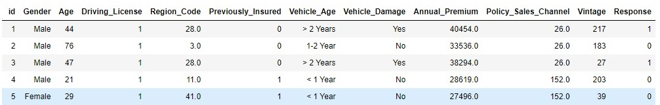
So, we have 381,109 samples of labeled data. The labels are the known values of response variable. The response is denoted as 1 for customer interested in vehicle insurance and 0 for customer not interested.
Therefore, our regression modeling task is a supervised learning, since we are dealing with a class of problem that relies on labeled data – i. e. known values of the target variable

Slide 5
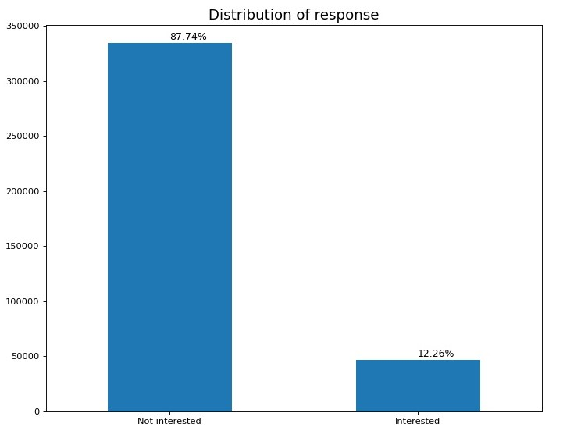
Exploratory Data Analysis
Observation
Our analysis shows that only 12.26% of all policy holders that had a health insurance were interested in vehicle insurance.

Slide 6
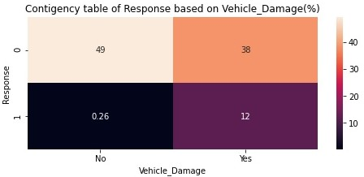
Observations 1) 49% of all policy holders with no vehicle damage in the past were not interested in a vehicle insurance. 2) 0.26% of all policy holders with no vehicle damage in the past were interested in a vehicle insurance. 3) 38% of all policy holders with a vehicle damage in the past were not interested in a vehicle insurance. 4) 12% of all policy holders with a vehicle damage in the past were interested in a vehicle insurance.

Slide 7
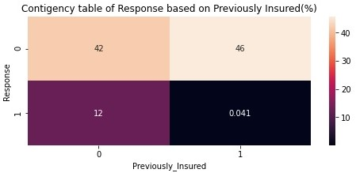
Observations 1) 42% of all policy holders had no vehicle insurance in the past and were not interested in a vehicle insurance. 2) 12% of all policy holders had no vehicle insurance in the past and were interested in a vehicle insurance 3) 46% of all policy holders had a vehicle insurance in the past and were not interested in a vehicle insurance 4) 0.041% of all policy holders had a vehicle insurance in the past and were interested in a vehicle insurance

Slide 8
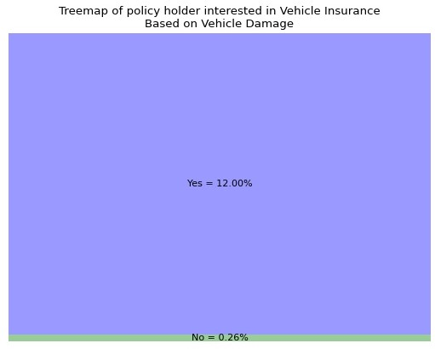
Observations
Out of all policy holders that were interested in a vehicle insurance, 12.00% had a vehicle damage in the past.
Out of all policy holders that were interested in a vehicle insurance, 0.26% did not have any occurrence of vehicle damage in the past.
We can clearly observe that the chances of requesting for a vehicle insurance increases if the policy holder have encountered a vehicle damage in the past

Slide 9
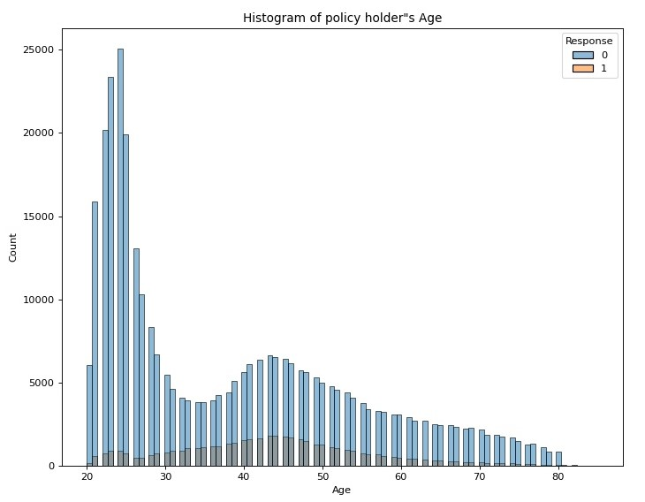
Observation
The distribution of policy holders that are interested in vehicle insurance approximates a normal distribution
Age 40 - 50 are more likely to be interested in vehicle insurance
Age 20 – 34 and above 60 are less likely to be interested in vehicle insurance

Slide 10
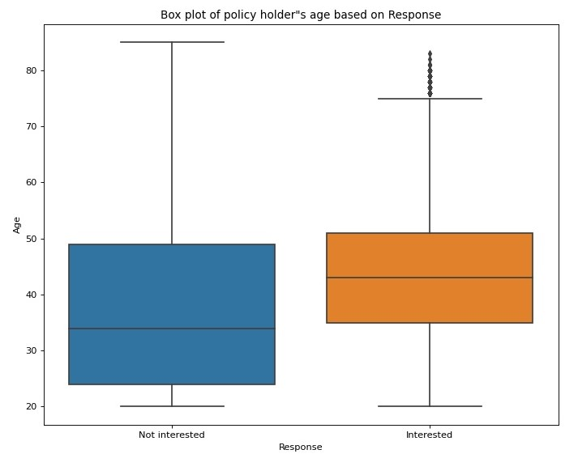
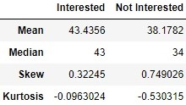
The distribution of policy holders
that are not interested in vehicle
insurance shows a bit of skewness
The median age of policy holders
that are interested in vehicle insurance
is 43 while the median age of policy
holders that are not interested in
vehicle insurance is 34

Slide 11
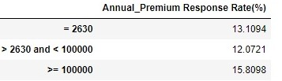
Further analysis by segmenting the customers into 3
categories of Annual Premium Payment , comparing
it with unsegmented one, we observed that:
1. Response rate of policy holders with annual
premium fee of 2,630 is 13.10% which is 0.84% more
than the expected response rate of 12.26%
2. Response rate of customer with annual premium
fee between 2,630 and 100,000 is 12.07% which is
0.19% less than the expected response rate of 12.26%
3. Response rate of policy holders with annual
premium fee greater 100,000 is 15.81% which is 3.55%
more than the expected response rate of 12.26%
We conclude that the chances that a health insurance
policy holder that has to pay 100,000 annual premium
will also go for vehicle insurance is 3.55%

Slide 12
Feature Engineering
Oversampling and undersampling are used to analyze the imbalances in our dataset.
SMOTE technique is used to tackle the imbalances

